Slide 1

Programming IoT

Slide 2
Content
Where programming is needed
Programming
Data and Big Data

Slide 3
Introduction
Programming IoT
https://courses.edx.org/courses/course-v1:CurtinX+IOT1x+2T2018/jump_to/block-v1:CurtinX+IOT1x+2T2018+type@vertical+block@8e4152b121a341e7af47d146795f8a4a

Slide 4
Note
What is programming?
The process of creating a set of instructions that tell a computer how to perform a task or sequence of tasks.
Machine might talk to the internet, but a person somewhere programmed it to do that. And a person figured out how the internet should respond to all of that data coming in, some of which is vast, or very fast, or very varied.

Slide 5
Programming IoT
Main considerations for programming IoT
https://courses.edx.org/courses/course-v1:CurtinX+IOT1x+2T2018/jump_to/block-v1:CurtinX+IOT1x+2T2018+type@vertical+block@75bb4c7b55f14d2488c34cac9d7648d3

Slide 6
Note
The main consideration for programming for IoT is that the small devices generally have:
Limited power supply
Limited computational power
Limited memory

Slide 7
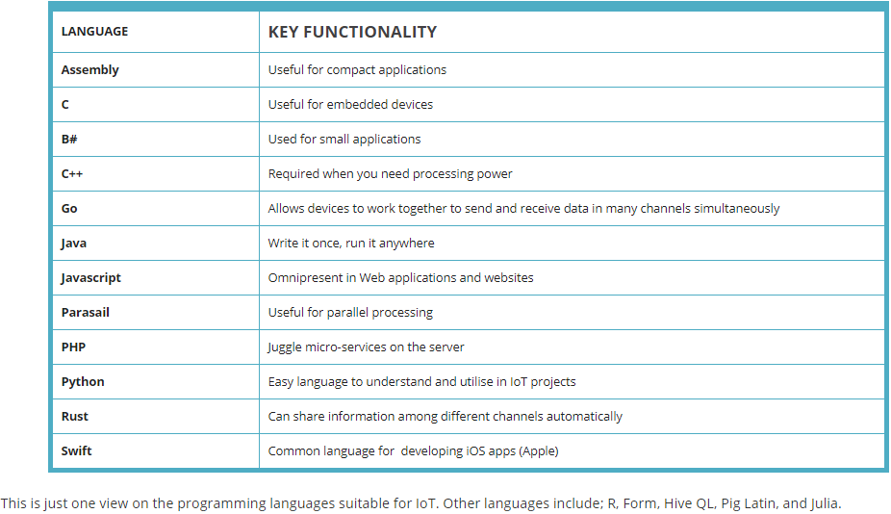
Note

Slide 8
Data and Big data
What is IoT Data ?
https://courses.edx.org/courses/course-v1:CurtinX+IOT1x+2T2018/jump_to/block-v1:CurtinX+IOT1x+2T2018+type@vertical+block@537f98092d8f46058dca126482e0eac3

Slide 9
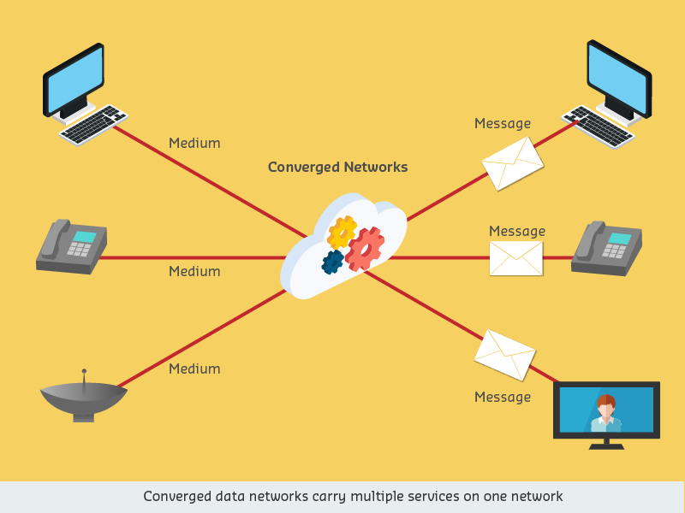
Note
The information itself is all becoming digital data

Slide 10
Data and Big Data
Digital Data
https://courses.edx.org/courses/course-v1:CurtinX+IOT1x+2T2018/jump_to/block-v1:CurtinX+IOT1x+2T2018+type@vertical+block@6c5c8cd700a544a48d1cdafed9bb3fec

Slide 11
Note
Data can be a telephone conversation, a television program, a web page, an email, an online theatre booking, or a series of readings from a sensor or instructions to a machine.
Digital data is data that is represented using a binary system of zeros (0) and ones (1).
Big data is data sets that have become so large and so complex that advanced programming and processing is required to capture the data, and then appropriately store, analyse, search, share, transfer, and visualise it.

Slide 12
Data and Big Data
The Pawsey Centre and Big Data
https://courses.edx.org/courses/course-v1:CurtinX+IOT1x+2T2018/jump_to/block-v1:CurtinX+IOT1x+2T2018+type@vertical+block@bec81f64bdf14ed7bb88549163b8d955

Slide 13
Data and Big Data
Real time data and historic data
https://courses.edx.org/courses/course-v1:CurtinX+IOT1x+2T2018/jump_to/block-v1:CurtinX+IOT1x+2T2018+type@vertical+block@48b969eb573940e3817f6afe1592a134

Slide 14
Data and Big Data
Data types
https://courses.edx.org/courses/course-v1:CurtinX+IOT1x+2T2018/jump_to/block-v1:CurtinX+IOT1x+2T2018+type@vertical+block@683f626b41dc4b94ba5870b2308dc7e9

Slide 15
Note
IBM describes the 4 V's of Big Data as:
Volume (quantity – big data observes and tracks what happens without sampling)
Velocity (speed – big data is generally available in real-time)
Variety (big data extracts from multiple sources such as text, images, audio, video)
Veracity (data quality – whether it stays true, or some is lost or damaged)

Slide 16
Data and Big Data
Playing with data
https://courses.edx.org/courses/course-v1:CurtinX+IOT1x+2T2018/jump_to/block-v1:CurtinX+IOT1x+2T2018+type@vertical+block@410b1d3df57845858223e2f59e74e974

